Slide 1



Slide 2



Digital portfolio
• • • •
Student name:R jayanthi
Register no:24131211802522028
Nmid:asanm121anm12124214028
Department:BSC COMPUTER science
College:Immaculate college for women

Slide 3
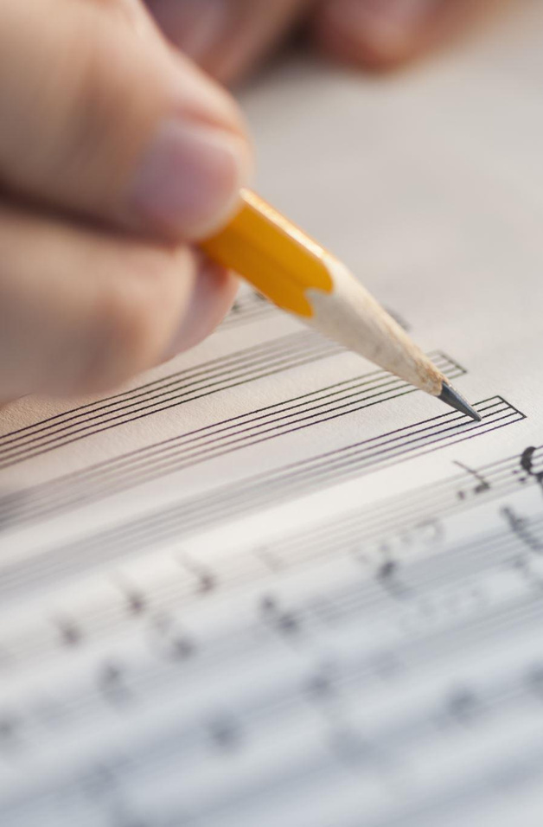
My skills
• •
Write and read Leaning music

Slide 4
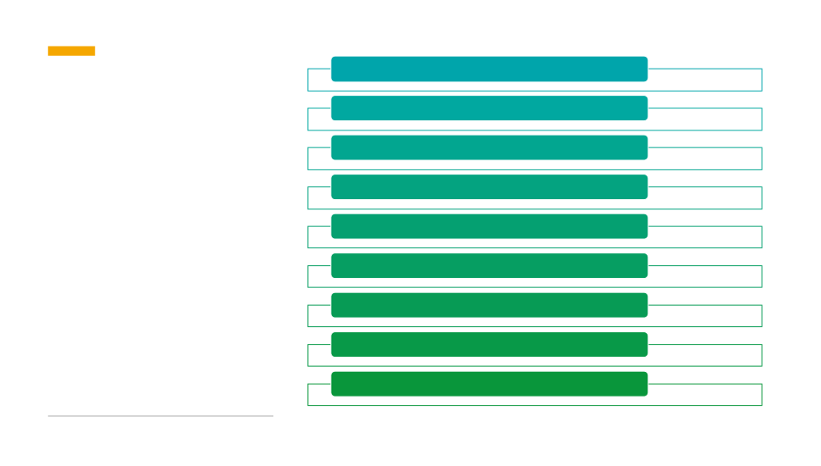
Problem statement
Project Overview
End Users
Tools and Technologies
Agenda
Portofolio design and Layout
Features and Functionality
Result and screenshots
Conclusion
Github link

Slide 5
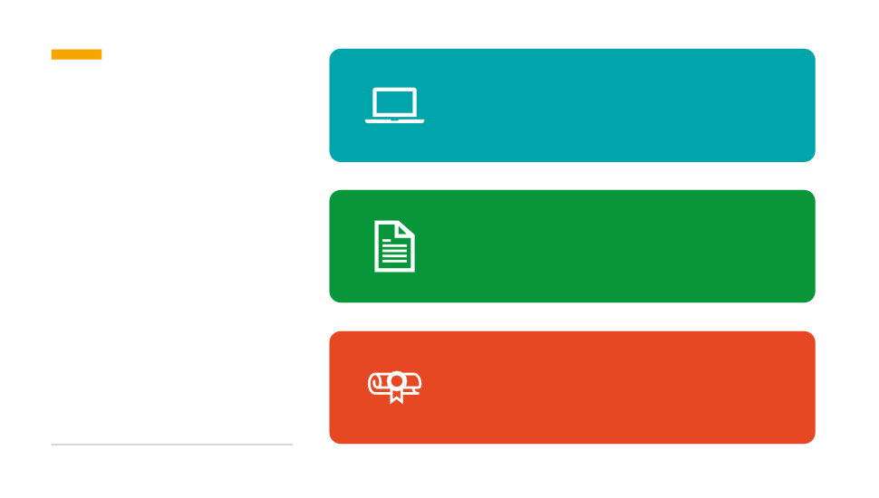
In the digital era having an online Portofolio is essential for showcaseing personal and professional details
Problem statement
Traditional resume are statics while a Portofolio website provides an Interactive way to highlight bio data, education, skills, and Project
The problem is that many students and job seeker to not have a simple, structure and visually appeating digital portfolio to present themselves.

Slide 6

The project aims to design and develop a person Portofolio web page using HTML and CSS.
Project Overview
The web page will contain the individual ‘s bio data, skills, Hobbies, education, and personal information in a structure table format
A profile picture and simple Layout enhance the professional look

Slide 7
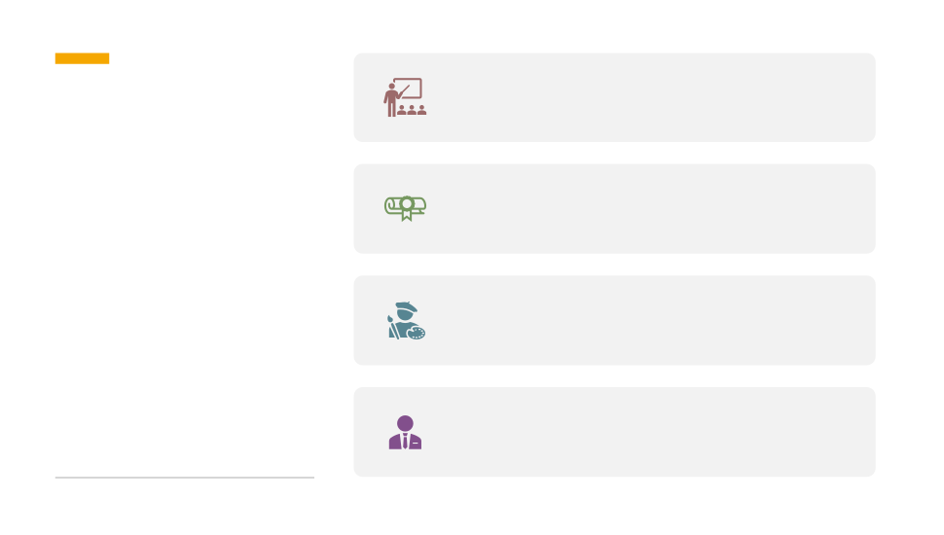
Student-to showcase their academic details and Skill
Job seeker-to present resumes digitally to employee
End Users
Freelancers-todemonstrate Skill and
personal branding
Professional-to maintain an online presence

Slide 8
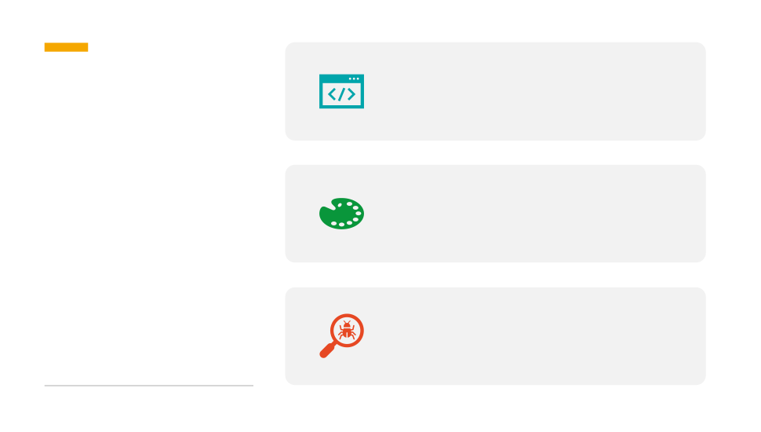
HTML-for creating the structureoftheportfolio
Tools and Technologies
CSS 3-for styling and Layout design
Webbrowser-fortesting
(choose, edge, firebox)

Slide 9
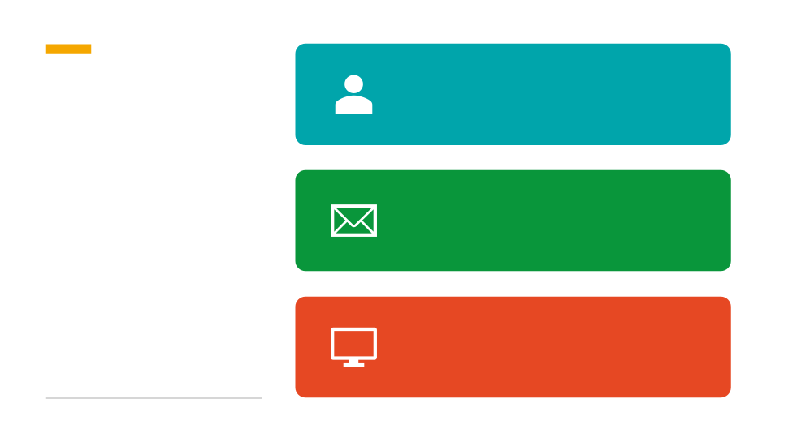
Header section-title and portfolio Picture
Portfolio Design and Layout
Table sections-bio data including
name,dob,email,phone, address,
education, skills and hobbies
Responsive- adjustabe for
desktop and mobile screen

Slide 10

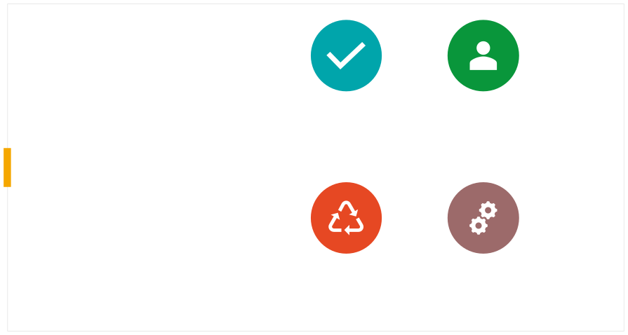
DISPLAY PERSONAL BIO DATA IN A CLEAR TABLE FORMAT
PROFILE PICTURE AT
THE TOP
Features and Functionality
RESPONSIVE AND USER-FRIENDLY DESIGN
SINPLE STRUCTURE FOR EASY CUSTOMIZATION

Slide 11

Result and screenshots
HOME PAGE WITH PROFILE
BIO DATA TABLE WITH DETAILS (NAME,EDUCATION, SKILLS, ETC)
PICTURE AND TITLE

Slide 12

Conclusion
It serves as a digital Identify for students and professional, making it
This project demonstrate how to create a simple yet effective portofolio web page using basic web
easierto share information
with Recruiters, institutions
technologies (HTML &CSS)
orclient

Slide 13

Github link
jayanthiravikumar11112006-png/Jayanthi-TNDSC-FWD-DP

